Slide 1


COMP2x0/VR220 Portfolio Development/ Worksheet Support Week 9: Talking About Your Work

Slide 2
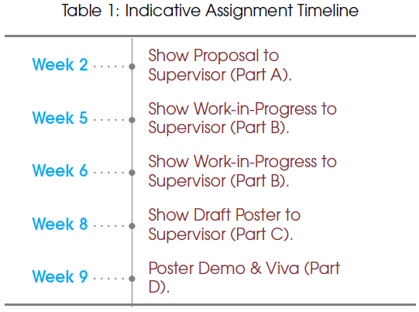
Timeline
Notes:
*** REMINDER: Upload poster PDFs to Mural ***

Slide 3
Portfolio Roadmap
Week | Topic
5 | Defining yourself: what is your USP?
7 | Portfolio design and structure
8 | Posters peer review
9 | Talking about your work
10 | Talking about yourself
11 | Online presence: CV/LinkedIn?
12 | Portfolio peer reviews?

Slide 4
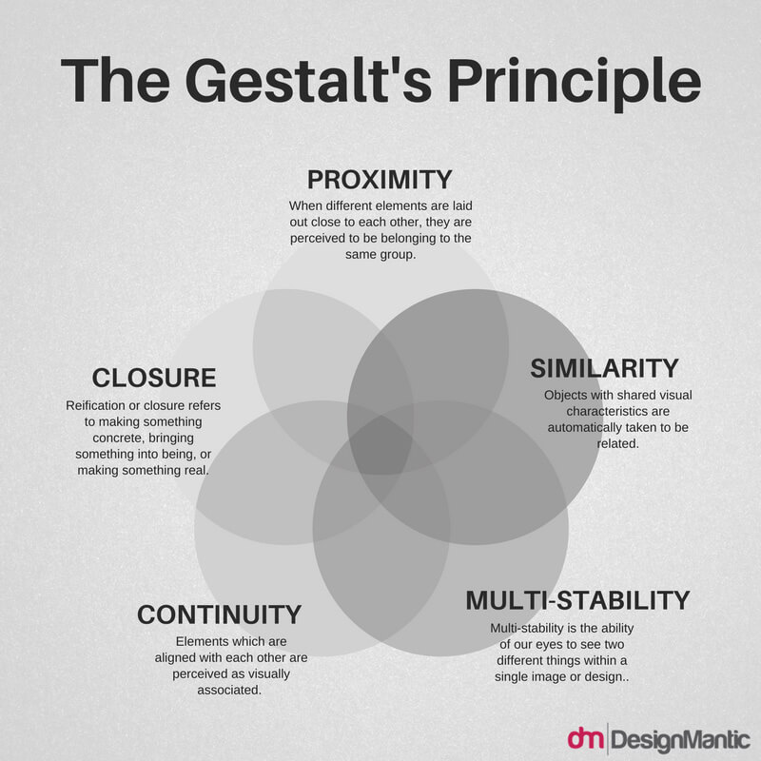
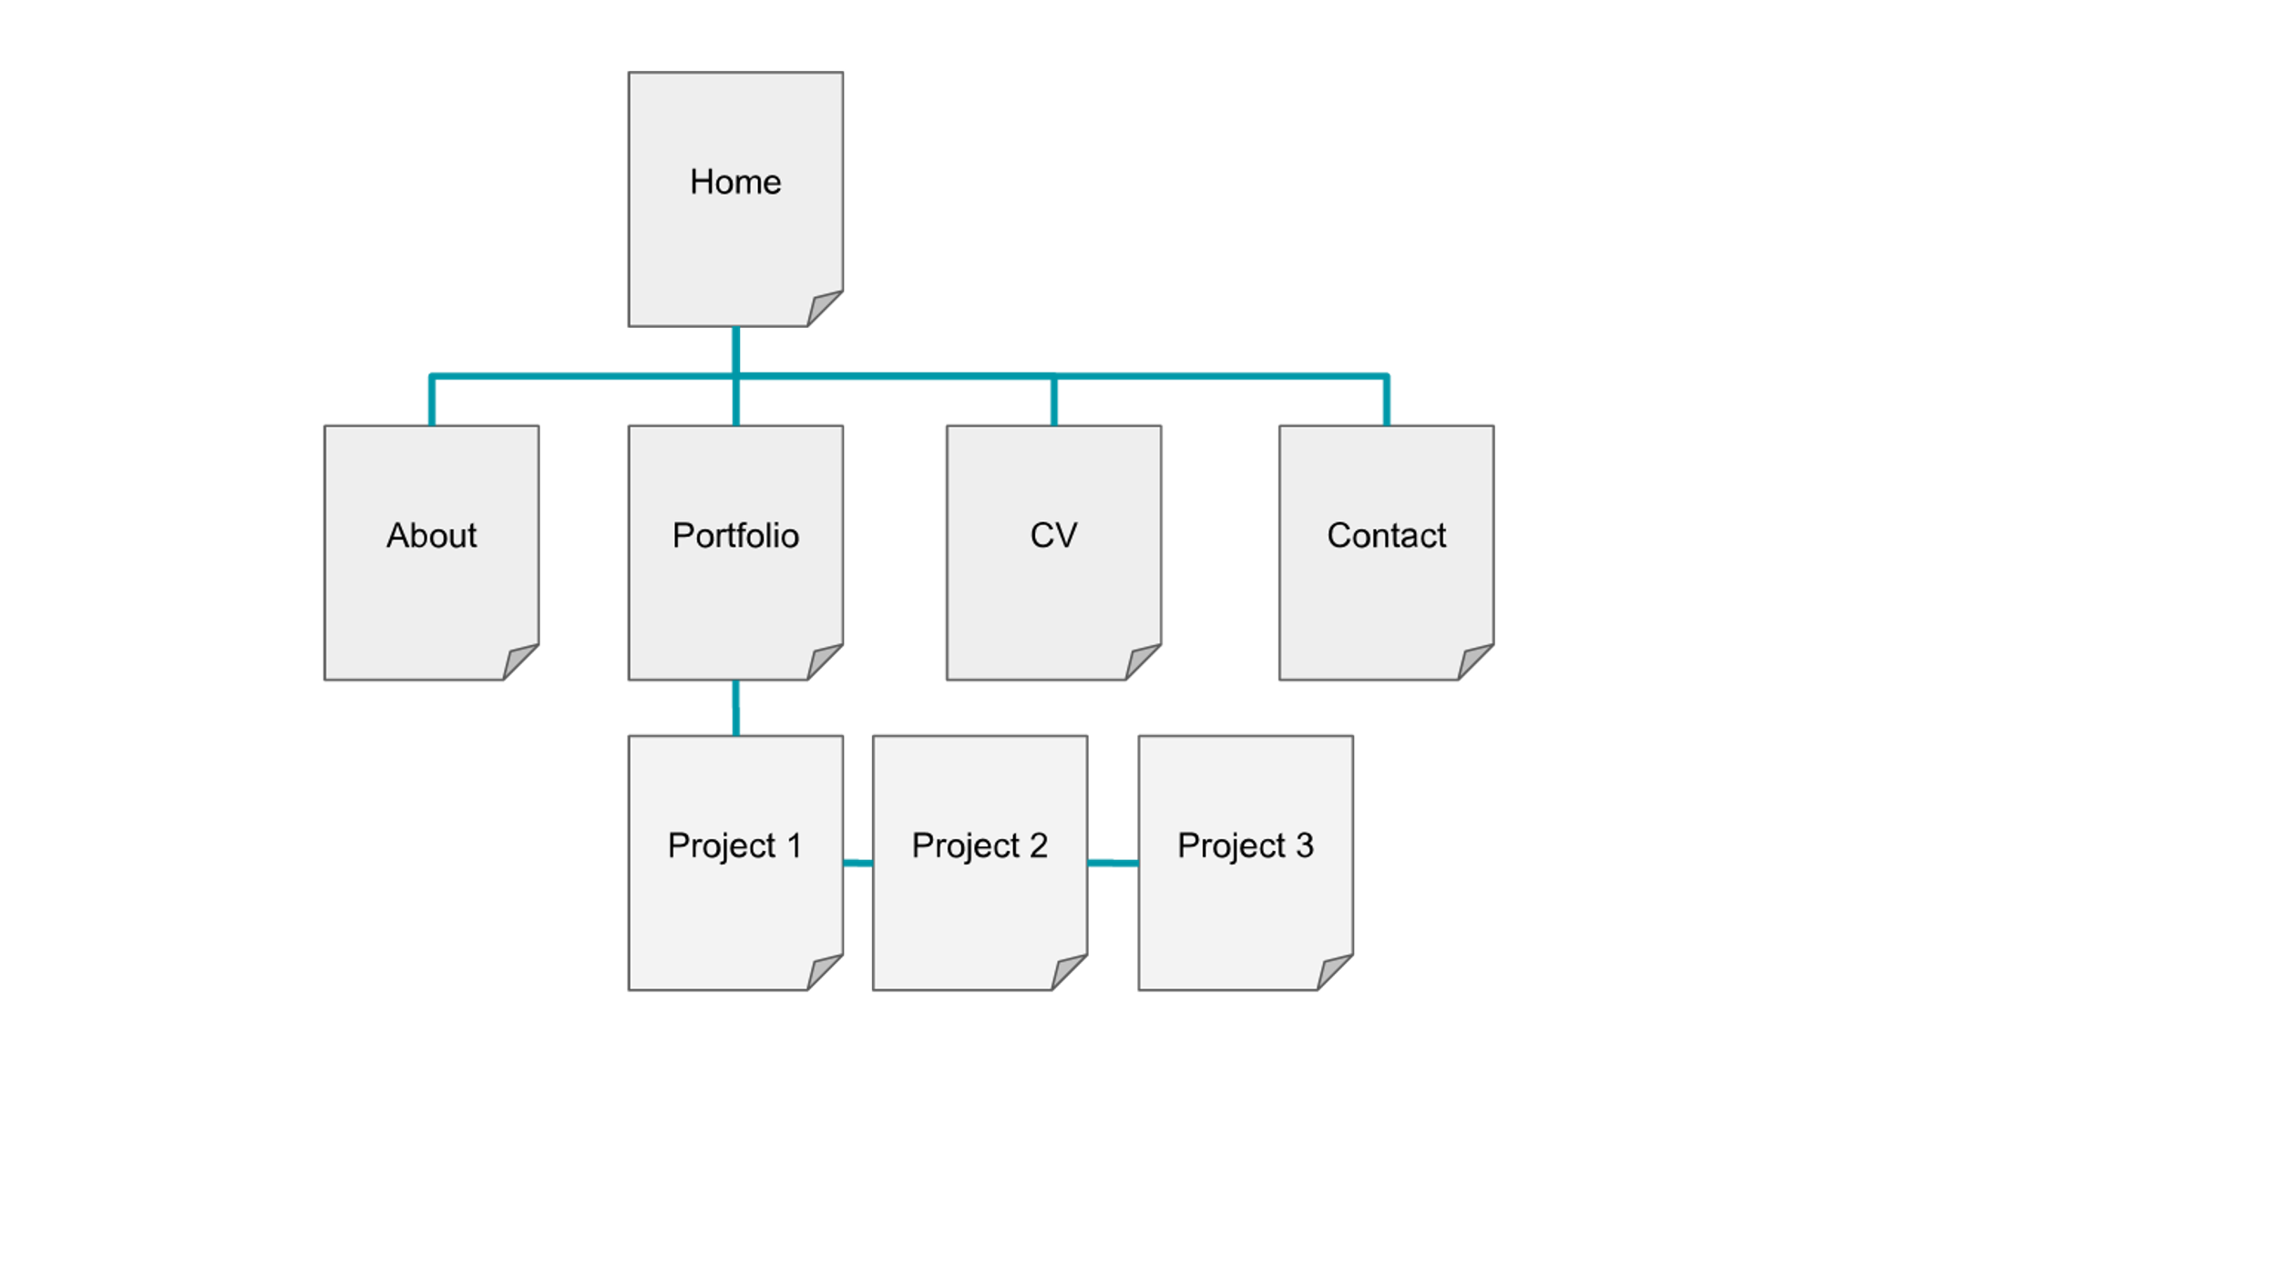
Previously…
Week 7

Slide 5
Asynchronous Task: Personal Brand
Week 5
Read how to Use a Personal Value Proposition to Land Your Next Job
Decide how you’d like to present yourself online:
Identify your strengths/USPs
Write an elevator pitch (or PVP) for yourself.
Use it to “introduce yourself” on this week’s Teams channel.
Collect examples of your work that support your brand.

Slide 6

Showing Off Your Skills
As a programmer (or possibly designer!) you need to sell the aspects that may not be seen.
Highlight your role in developing features.
Emphasise technical innovations or programmatic solutions you discovered.
Discuss the development process and include justified decisions.

Slide 7
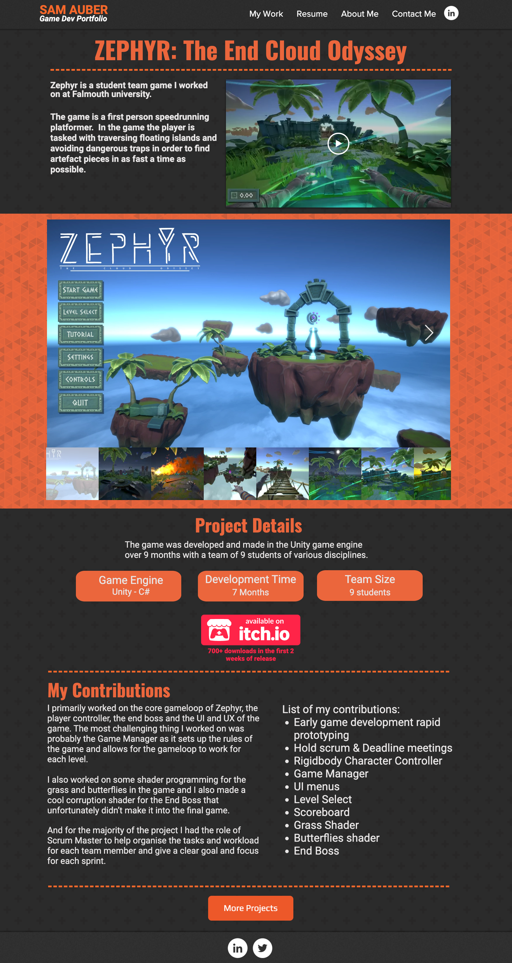
Project Description
Brief outline/elevator pitch
Project spec/aims/ambitions
Principal achievements
Details of your role and innovations
Include visual evidence: images, video, diagrams etc.
https://www.samauber.me/zephyr

Slide 8
Telling a Story
Set the Scene: necessary background information; how did this lead to the idea for your project? Who are the “main characters”? Introduce tension as the problem to solve.
The Adventure: how did you arrive at the design for your project, and what did you find on the way? Were there any plot twists?!
The Conclusion: where did you end up, and what does it mean for your “characters”? Will there be a sequel?
More info:
https://www.scientifica.uk.com/neurowire/tips-for-presenting-your-scientific-poster-at-a-conference
https://www.annaclemens.com/blog/story-structure-scientific-paper

Slide 9
Activity: Storytime
Choose a project you’ve worked on recently
Identify the starting point, motivation and characters (could be players/users, algorithms, techniques…), as well as any key plot points or incidents and the final outcome.
Describe your development process as a story: “Once upon a time…”
Remember to introduce tension: “however”, “despite”, “although”
Listeners can offer prompts, e.g. “what happened next”, “why/how did they/you do that” etc.
Tell your own stories or choose one to develop as a group

Slide 10
Story Example
“Once upon a time, there was a CG bear named Paddington. He was to star in his own movie, for which he had to look just like a real bear (albeit one who talks). There were talented animators who could move his face and limbs just so, but something wasn’t quite right: he looked somehow rigid and unnatural.
“Closer inspection revealed that, although he was modelled as endearingly tubby, his body didn’t move the way it should: there was no wobble! It would have taken the animators too much time to move every single vertex of his skin mesh in the right way, so an automated solution was required.
“Various techniques exist that can simulate soft tissue, though many still require significant human intervention. One technique that previously hadn’t been tried (due to limitations in computing power) was a method commonly used in engineering, based on balancing internal forces of stress and strain…”

Slide 11
Asynchronous Task: Describe a Project
Write a description for a project you’ve worked on, using it to highlight your skills relevant to an area you’d like to work in.
Add this description to your portfolio website, including any relevant images and/or video clips.

